Slide 1
SIG AI
<welcome to>
Meeting 1: 02/21/24

Slide 2
What is AI?
Artificial intelligence (AI) is technology that enables computers and digital devices to do things humans do and build necessary technology to get there.
AI Winters & Summers! (more on this later)
A better definition by John MCCarthy: What is Artificial Intelligence
Notion of modelling after biological systems: Boston Dynamics and the Human arm
No turning point post-ChatGPT revolution
In 1997, IBM Blue beats Kasparov at Chess (twice!)
My personal favourite: AlphaGo Documentary | YouTube | Free
The victory is significant given the huge number of possible moves as the game progresses (over 14.5 trillion after just four moves!). Later, Google purchased DeepMind for a reported USD 400 million.
Notes:
Even skeptics agree no turning back from ChatGPT. It has taken AI way outside the scope and context of just programmers, and not just in a ‘i know the latest buzzword’ way but in a much direct context, everyday use context.
AI Winters: 1974–1980 and 1987–2000

Slide 3
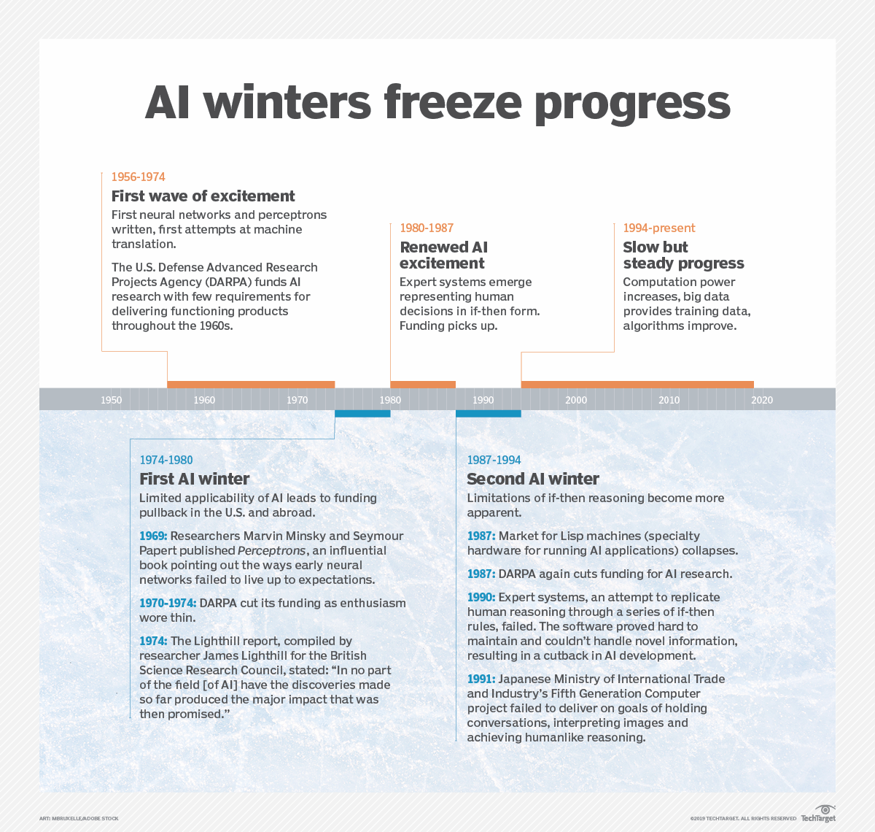
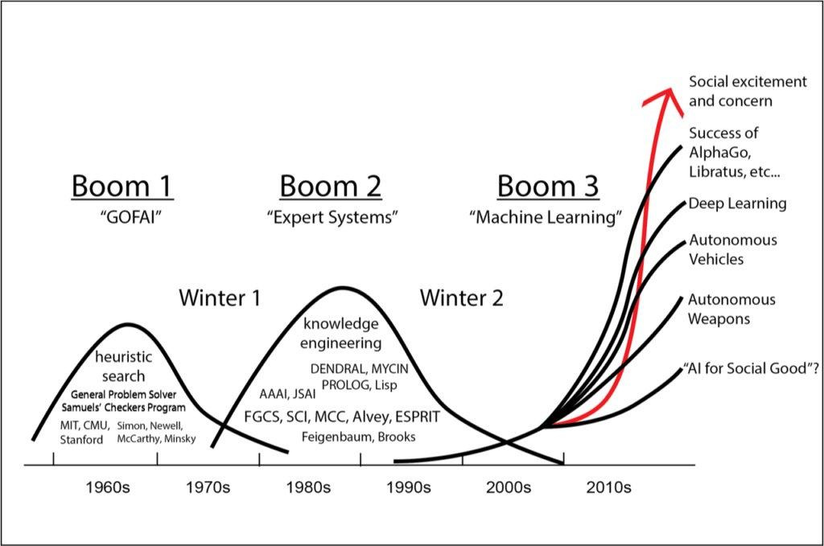
AI Winter
Notes:
Most of the AI Winter was about vendors making promises and falling short fo them. In terms of technology, being 6 years behind schedule is A LOT LIKE LYING. This is also a con when research is led by industry instead of academic. It’s mainly designed to be profit-driven, to out-compete competitors and basically, culminate into a product. If it doesn’t do that, it’s over.

Slide 4
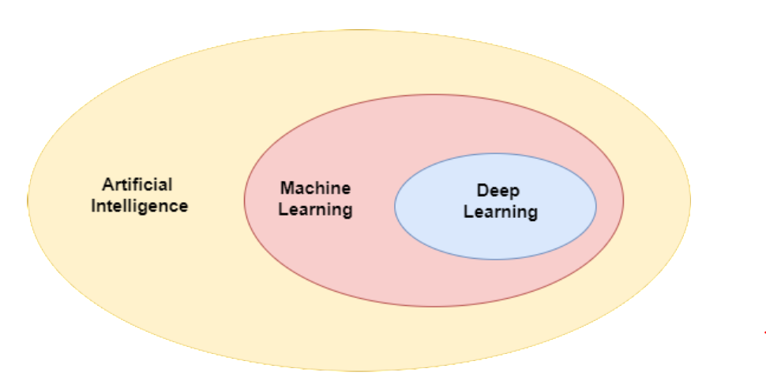
Whose their daddy?
Notes:
So, all of the structuring depends on who you ask.

Slide 5
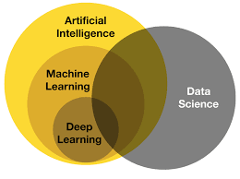
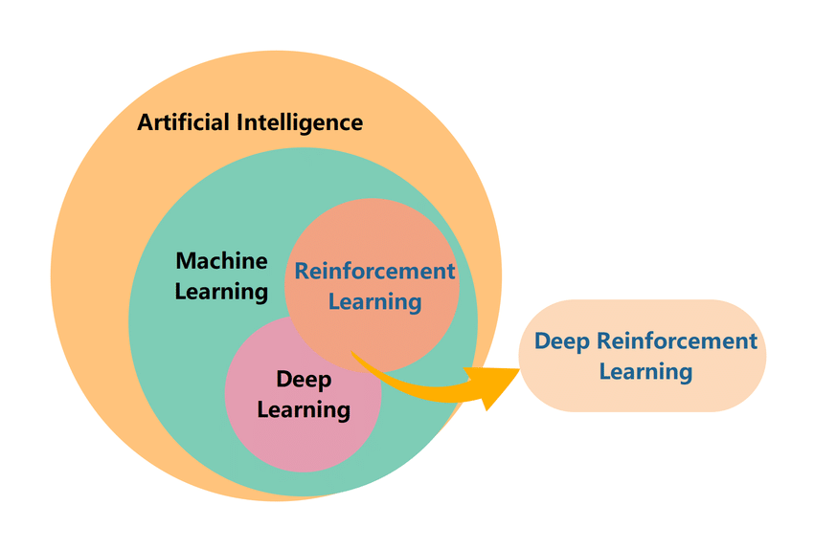
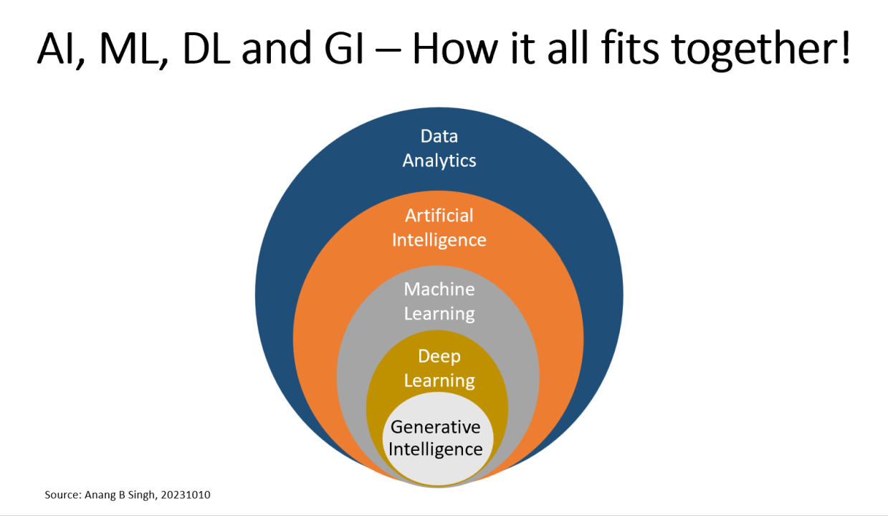
Data Scientists
Deep Learning Focus Groups

Slide 6
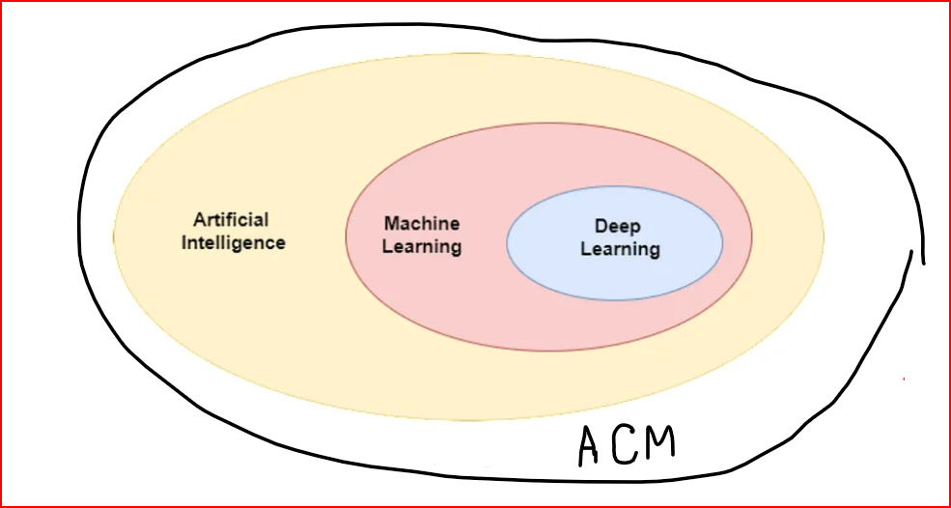
Notes:
If you ask me, this is what I am calling it! Unironically, this is also how seriously categorisation within domains and lines between different AI technologies is you should take.

Slide 7
But, what do we agree* on?
Unsupervised Learning
Deep
Learning
do not have labelled data, learn more about the data by inferring patterns in the dataset without reference to the known outputs
learning from examples, computer model to filter the input data through layers to predict and classify information (layers >3)
Supervised Learning
Reinforcement Learning
takes a known set of input dataset and its known responses to the data (output) to learn the regression/classification model.
an agent learns from an interactive environment in a trial and error way by continuously using feedback from its previous actions and experiences
Notes:
We agree that these mean 4 different things. That’s all.

Slide 8
But, what do we agree on?
Unsupervised Learning
Deep
Learning
market segmentation and image compression
LLMs aka Large Language Models: ChatGPTTTTTTTTT
Supervised Learning
Reinforcement Learning
image classification and spam detection
game-playing AI that improves over time eg: AlphaGo
Notes:
Deep Learning
is like a self-learning artist. Imagine you give this artist a bunch of pictures of cats and dogs. At first, the artist knows nothing about what cats and dogs look like. But as they go through the pictures, they start noticing features on their own - like dogs have different ear shapes while cats’ ears are mostly the same, or dogs can be big or small while cats are usually small. Over time, with lots of pictures (data), the artist becomes really good at telling dogs and cats apart just by looking at them.
Supervised Learning,
on the other hand, is like a student with a very attentive teacher. The teacher already knows what cats and dogs look like. They guide the student through the learning process, pointing out the features of cats and dogs in the pictures. For example, the teacher might say, “This is a dog because it has a long snout, and this is a cat because it meows.” The student learns to recognize cats and dogs based on the features pointed out by the teacher.
Reinforcement Learning
is like training a dog. You don’t tell the dog exactly what to do. Instead, you reward the dog (give it a treat) when it does something you want, like sitting or fetching a ball. Over time, the dog learns to perform these actions to get more treats. Similarly, in reinforcement learning, an algorithm learns to perform actions that yield the highest reward.
Unsupervised Learning,
on the other hand, is like a toddler exploring a room full of toys. The toddler doesn’t know what each toy does, but by playing around (clustering and associating), they start to understand - blocks can be stacked, balls can be rolled, etc. Similarly, in unsupervised learning, the algorithm explores the data and starts finding patterns and structures without any prior knowledge.
In unsupervised learning the output would not be something such as telling whether its a cat or a dog. Here its more of grouping data or categories by finding more patterns.The goal in unsupervised learning is to find similarities and differences between data-points.

Slide 9
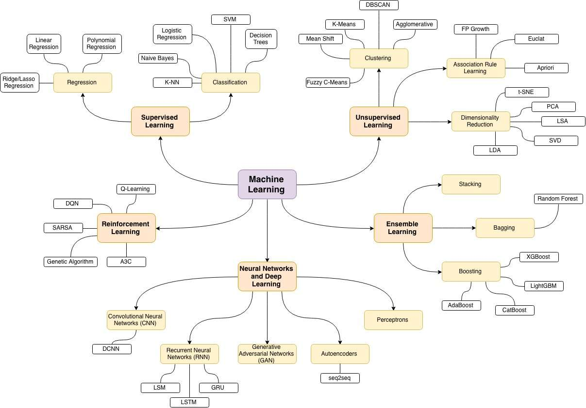

Slide 10
Schedule
2/22 | Introduction to all, basics of Supervised Learning
3/7 | Supervised Learning contd.
3/21 | Unsupervised Learning
4/4 | Deep Learning
4/18 | Reinforcement Learning
Notes:
Am I going to discuss all of it? Clearly, no. Will we discuss the basics, build an intuition and understand important parts of each? YES.

Slide 11
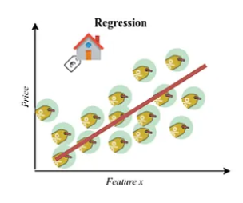
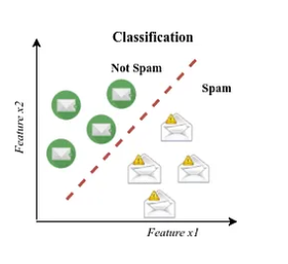
Supervised Learning
Regression
Classification
Notes:
Regression deals in continuous values and outputs a discrete value.
Classification deals in categorical data and has yes/no answers.

Slide 12
Supervised Learning
Regression
Classification
Act on continuous target variables
Aim for decreasing error between predicted and actual values
build a model that can accurately assign a label or category to a new observation based on its features
predict discrete target variables(class labels) using independent features or find a decision boundary that can separate the different classes in the target variable.
Validated with confusion matrix, precision & recall and cross-validation
Notes:
Both prone to Overfitting and Underfitting: if the model learns the training too well and doesnt generalise to test set or other datasets
Confusion matrix: A table that shows the number of true positives, true negatives, false positives, and false negatives for each class, which can be used to calculate various evaluation metrics.
Precision and Recall: Precision measures the proportion of true positives over the total number of predicted positives, while recall measures the proportion of true positives over the total number of actual positives. These metrics are useful in scenarios where one class is more important than the other, or when there is a trade-off between false positives and false negatives.

Slide 13
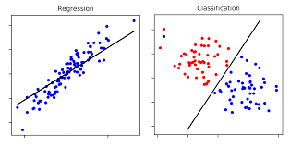
Supervised Learning
Regression
Classification
Notes:
Both prone to Overfitting and Underfitting: if the model learns the training too well and doesnt generalise to test set or other datasets
Confusion matrix: A table that shows the number of true positives, true negatives, false positives, and false negatives for each class, which can be used to calculate various evaluation metrics.
Precision and Recall: Precision measures the proportion of true positives over the total number of predicted positives, while recall measures the proportion of true positives over the total number of actual positives. These metrics are useful in scenarios where one class is more important than the other, or when there is a trade-off between false positives and false negatives.

Slide 14
Supervised Learning
Regression
Classification
Which of the following is NOT a regression task:
Predicting age of a person
Predicting nationality of a person
Predicting whether stock price of a company will increase tomorrow
Predicting whether a document is related to sighting of UFOs?
Which of the following is NOT a regression task:
Predicting the age of a car based on its mileage
Predicting whether a person will buy a product or not based on their browsing history
Predicting the score of a student in an exam based on their study hours
Predicting the price of a stock next week based on past prices?
Which of the following is NOT a classification task:
Predicting whether an email is spam or not based on its content
Predicting the breed of a dog based on its physical characteristics
Predicting the height of a person based on their parents’ heights
Predicting whether a credit card transaction is fraudulent or not?
Which of the following is NOT a classification task:
Predicting whether a patient has a disease or not based on their symptoms
Predicting the species of a flower based on measurements of its petals
Predicting the temperature tomorrow based on weather data
Predicting whether a passenger survived on the Titanic based on their age, class, and gender?

Slide 15
Supervised Learning
Regression
Classification
Linear Regression
Logistic Regression
On continuous data, finding a best fit line
On categorical data, finds bet fit probability curve while doing binary classification
K-NN
Naive Bayes
Decision Trees
Groups data depending on it’s nearest neighbours
assumes that the presence of a particular feature in a class is unrelated to the presence of any other feature all of these properties independently contribute to the probability. This method is easy to build, particularly for very large data sets.
partition based on the attribute value. It partitions the tree recursively in a manner called recursive partitioning
Notes:
Linear Regression: Suppose you’re saving money for a new bike. You save a certain amount each week. After a few weeks, you notice that the total amount you’ve saved is directly proportional to the number of weeks you’ve been saving. Linear regression is like this - it finds a straight line that best fits the data points
Logistic Regression: Imagine you’re trying to predict whether it will rain tomorrow or not. You look at the weather today - if it’s cloudy, you think there’s a higher chance of it raining tomorrow. If it’s sunny, you think there’s a lower chance. Logistic regression is like this process - it takes in features (like today’s weather) and outputs a probability between 0 and 1 (like the chance of rain tomorrow)
K-Nearest Neighbors (K-NN): Imagine you’re at a party and you don’t know anyone. You start to make friends by finding people who are similar to you. If you find a group of people who all like the same music as you, you’d probably get along with them. K-NN works in a similar way - it classifies a data point based on the ‘labels’ of its nearest neighbors
Naive Bayes: Let’s say you’re a detective trying to solve a mystery. You make assumptions based on the evidence you have, even if those pieces of evidence are related to each other. Naive Bayes works similarly - it calculates the probability of an event occurring given some evidence, assuming that the evidence is independent
Decision Trees: Imagine you’re playing a game of 20 questions. Each question you ask splits the possible answers into two groups, helping you narrow down the answer. Decision trees work like this game - they make decisions by splitting the data into two or more homogeneous sets based on the most significant attributes

Slide 16
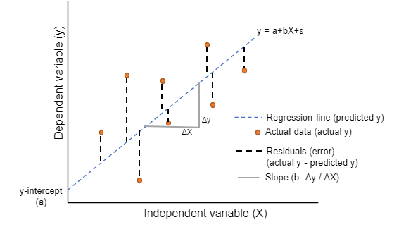
Linear Regression
assumes that there is a linear relationship between the independent and dependent variables, this means that the change in the dependent variable is proportional to the change in the independent variables
y = f(x)
Say, f(x) = x + 7, whatever value of x is put in this equation, will decide what value y gets.
x is independent bc it calls the shots, y is dependent bc it’s value is a result of operations on x
Notes:
Assumption of linearity or linear dependence

Slide 17
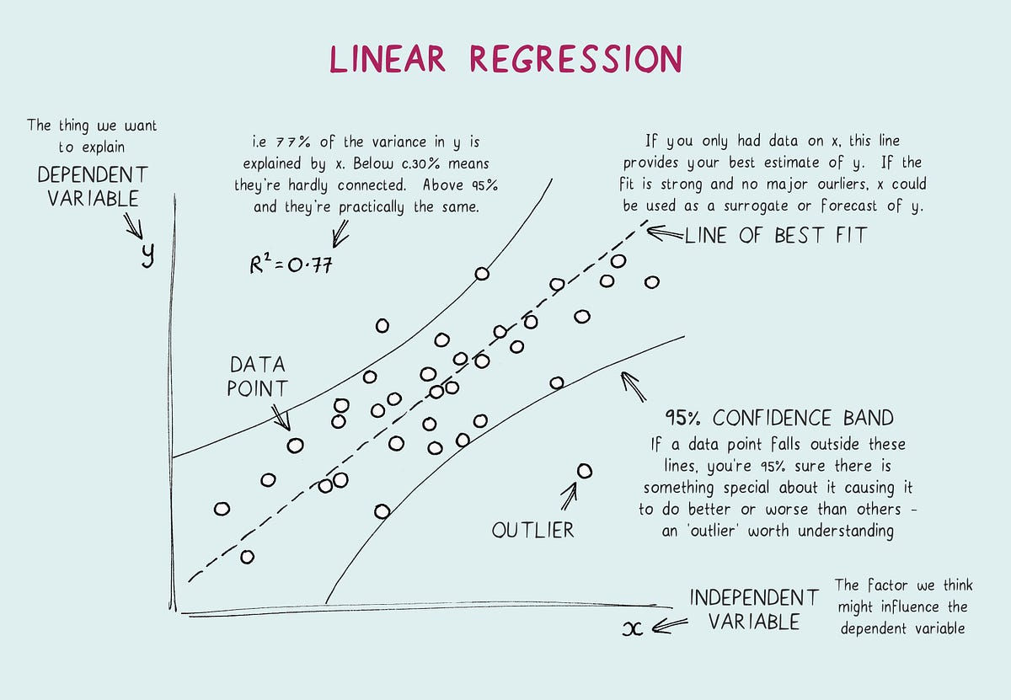
Linear Regression
Notes:
assumes that there is a linear relationship between the independent and dependent variables, this means that the change in the dependent variable is proportional to the change in the independent variables
Y = f(x)
Say, f(x) = x + 7, whatever value of x is put in this equation, will decide what value y gets.
X is independent bc it calls the shots, y is dependent bc it’s value is a result of operations on x
Explain removing data points w.r.t a particular confidence band
Example: predicting house prices
Question:
Which of the following scenarios is NOT ideal for applying Linear Regression:
Predicting a person’s weight based on their height, when the relationship between weight and height is non-linear
Predicting the price of a house based on its size and location, when the relationship between size, location and price is linear
Predicting a car’s fuel efficiency based on its engine size and age, when the relationship between engine size, age and fuel efficiency is linear
Predicting the sales of a product next month based on past sales data, when the sales data shows a clear upward trend?
Answer: Predicting a person’s weight based on their height, when the relationship between weight and height is non-linear

Slide 18
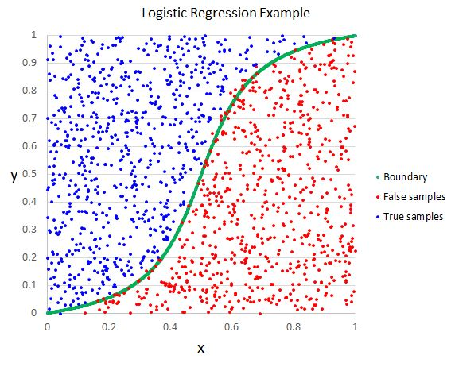
Logistic Regression
Similar to Linear regression except 2 things:
out a singular value (of probability)
Used for categorical data
There should not be collinearity between independent variables.
Notes:
Independent observations: Each observation is independent of the other. meaning there is no correlation between any input variables.
Binary dependent variables: It takes the assumption that the dependent variable must be binary or dichotomous, meaning it can take only two values. For more than two categories SoftMax functions are used.
Linearity relationship between independent variables and log odds: The relationship between the independent variables and the log odds of the dependent variable should be linear.
No outliers: There should be no outliers in the dataset.
Large sample size: The sample size is sufficiently large
Predicting whether a customer will leave based on historical data : spam detection

Slide 19
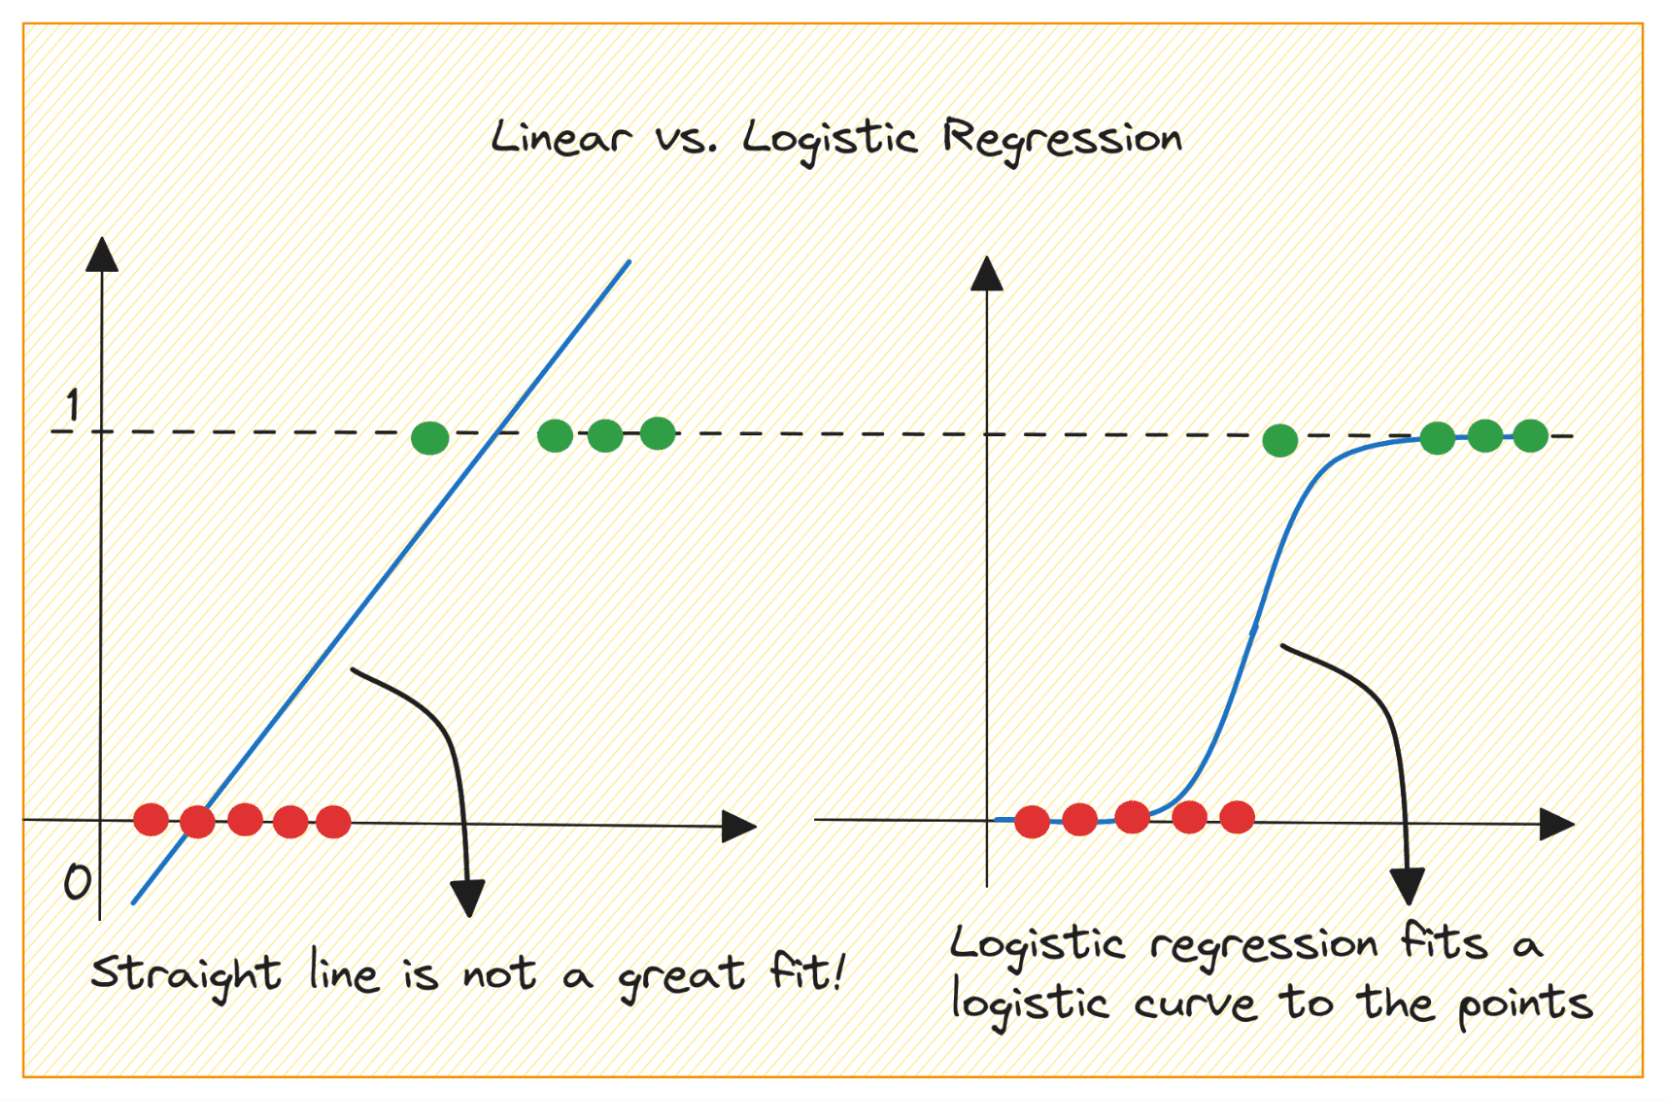
Logistic Regression
Similar to Linear regression except 2 things:
out a singular value (of probability)
Used for categorical data
Notes:
For true-false values and the general purpose of binary classification, we need logistic regression
In logistic regression, having collinear variables can cause several problems:
Unstable Estimates: When predictor variables are highly correlated, the estimates of the coefficients can become unstable and vary greatly with small changes in the data or the model. This can make the model’s predictions unreliable, we’re mapping x with log of y
Interpretability Issues: Logistic regression coefficients represent the change in the log odds of the outcome for a one unit increase in the predictor variable, assuming all other variables are held constant. When predictors are highly correlated, it’s no longer possible to change one “while holding all others constant” because they move together. This makes it difficult to interpret the coefficients.
Multicollinearity: In severe cases, if two predictors are perfectly correlated, it leads to a situation called multicollinearity where the mathematical algorithm behind logistic regression cannot run.
Logistic Regression: Which of the following scenarios is NOT ideal for applying Logistic Regression:
Predicting whether an email is spam or not based on its content
Predicting the breed of a dog based on its physical characteristics
Predicting whether a credit card transaction is fraudulent or not
Predicting whether a passenger survived on the Titanic based on their age, class, and gender
Answer: Predicting the breed of a dog based on its physical characteristics, when the decision boundary is non-linear
Logistic Regression can only be used for binary classification problems

Slide 20
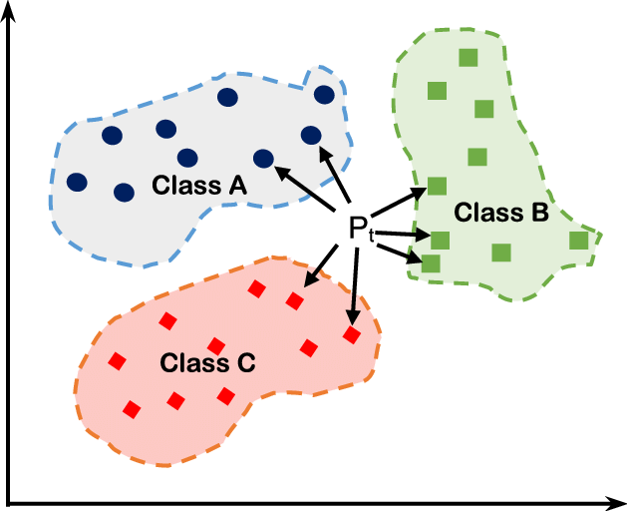
K-NN
non-parametric
given an unclassified point, we can assign it to a group by observing what group its nearest neighbors belong to. This means a point close to a cluster of points classified as ‘Red’ has a higher probability of getting classified as ‘Red’
Increasing k doesn’t necessarily lead to a better classification
less sensitive to outliers compared to other algorithms
Notes:
Non-parametric: no underlying assumptions about data
Advantages:-
No Training Period- KNN modeling does not include training period as the data itself is a model which will be the reference for future prediction and because of this it is very time efficient in term of improvising for a random modeling on the available data.
Easy Implementation- KNN is very easy to implement as the only thing to be calculated is the distance between different points on the basis of data of different features and this distance can easily be calculated using distance formula such as- Euclidian or Manhattan
As there is no training period thus new data can be added at any time since it wont affect the model.
Disadvantages:-
Does not work well with large dataset as calculating distances between each data instance would be very costly.
Does not work well with high dimensionality as this will complicate the distance calculating process to calculate distance for each dimension.
Sensitive to noisy and missing data
Feature Scaling- Data in all the dimension should be scaled (normalized and standardized) properly .
suggest similar products based on
buying& looking
perspectives

Slide 21
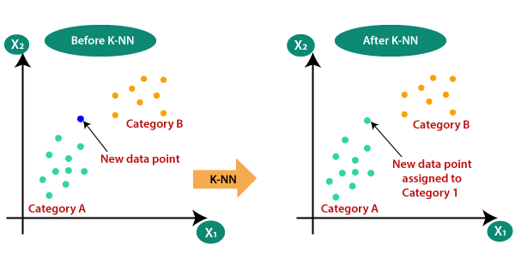
K-NN
Notes:
Non-parametric: no underlying assumptions about data

Slide 22
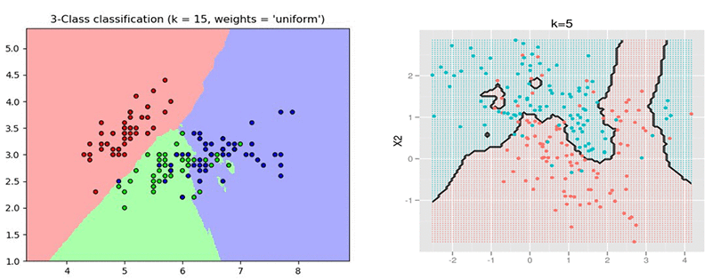
K-NN
Notes:
Non-parametric: no underlying assumptions about data

Slide 23
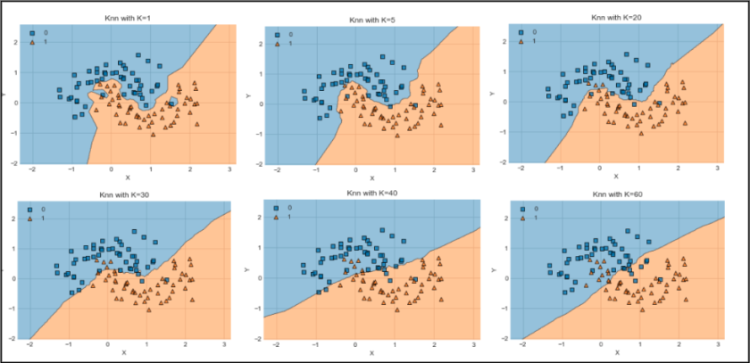
K-NN
Notes:
Non-parametric: no underlying assumptions about data
The k-Nearest Neighbors (k-NN) algorithm can struggle with large datasets for a few reasons:
Computational Complexity: k-NN is a distance-based algorithm. For each prediction, it calculates the distance between the new observation and every other point in the dataset. This can be computationally intensive and time-consuming when the dataset is large.
Memory Usage: k-NN is a lazy learning algorithm, meaning it doesn’t learn a discriminative function from the training data but memorizes the training dataset instead. So, the entire dataset needs to be stored in memory, which can be a problem if the dataset is large.
Dimensionality: In high-dimensional spaces (i.e., when there are many features), the concept of “closeness” or “distance” can become less meaningful, making k-NN less effective. This is known as the “curse of dimensionality,” and it affects all distance-based algorithms.
Noise: k-NN can be sensitive to noise in the dataset. In large datasets, the likelihood of having noisy or irrelevant features increases, which can negatively impact the performance of k-NN.
Therefore, while k-NN can be a powerful algorithm for small to medium-sized datasets, it’s often not the best choice for very large datasets. Other algorithms, like tree-based methods or deep learning, might be more suitable for such cases. 😊
Question:
K-Nearest Neighbors (K-NN): Which of the following scenarios is NOT ideal for applying K-NN:
Classifying a fruit as either an apple or an orange based on its color and size, when the training dataset is small
Predicting whether a patient has a disease or not based on their symptoms, when the training dataset is very large
Predicting whether a document is related to sighting of UFOs, when the number of features (words in the document) is very large
Predicting the species of a flower based on measurements of its petals, when the training dataset is small?
Answer: Predicting whether a patient has a disease or not based on their symptoms, when the training dataset is very large

Slide 24
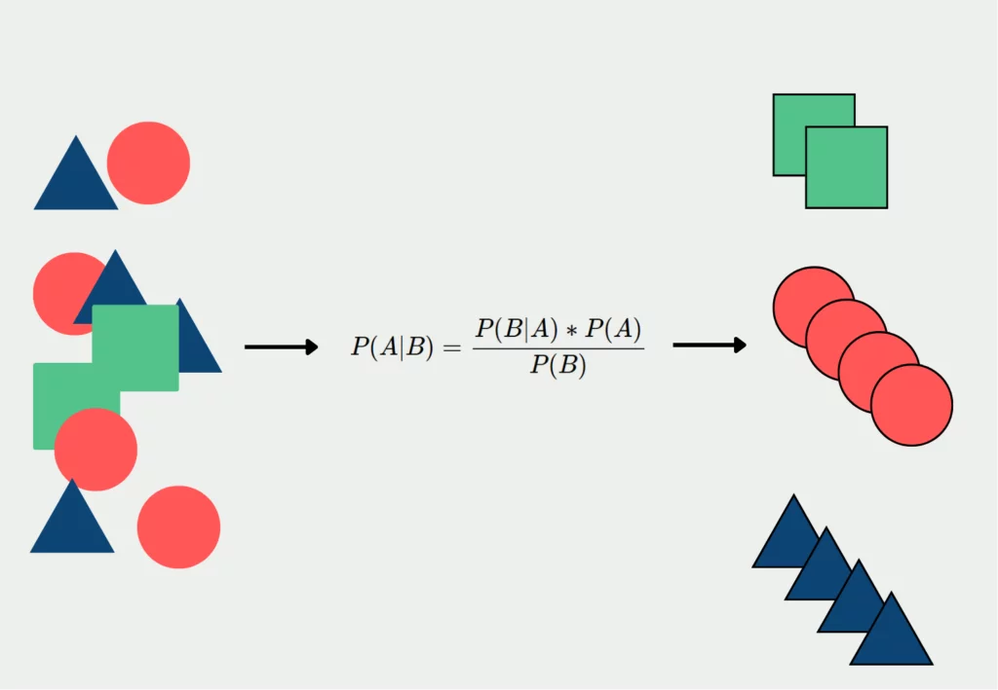
Naive Bayes
a collection of classification algorithms based on Bayes’ Theorem. It is not a single algorithm but a family of algorithms where all of them share a common principle, i.e. every pair of features being classified is independent of each other
Why ‘Naive’? - classifier assumes that the features used to describe an observation are conditionally independent
Notes:
With relation to our dataset, this concept can be understood as:
We assume that no pair of features are dependent. For example, the temperature being ‘Hot’ has nothing to do with the humidity or the outlook being ‘Rainy’ has no effect on the winds. Hence, the features are assumed to be independent.
Secondly, each feature is given the same weight(or importance). For example, knowing only temperature and humidity alone can’t predict the outcome accurately. None of the attributes is irrelevant and assumed to be contributing equally to the outcome.
—
Probability of event A, given B is true [both being independent of each other]
Basically, we are trying to find probability of event A, given the event B is true. Event B is also termed as evidence.
P(A) is the priori of A (the prior probability, i.e. Probability of event before evidence is seen). The evidence is an attribute value of an unknown instance(here, it is event B).
P(B) is Marginal Probability: Probability of Evidence.
P(A|B) is a posteriori probability of B, i.e. probability of event after evidence is seen.
P(B|A) is Likelihood probability i.e the likelihood that a hypothesis will come true based on the evidence.
Example: Sentiment analysis of texts [most overused
project =
Twitter sentiment
analysis]

Slide 25
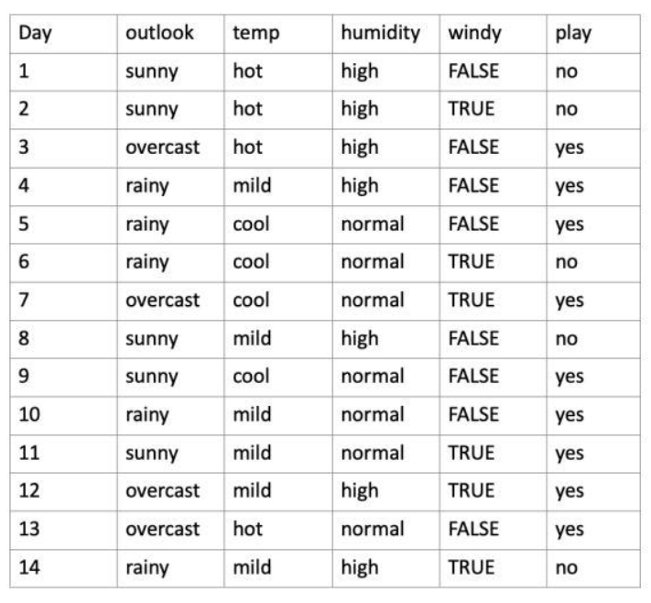
X (feature vector) = (Sunny, Hot, Normal, False)
y = No
So basically, P(y|X) here means, the probability of “Not playing golf” given that the weather conditions are “Sunny outlook”, “Temperature is hot”, “normal humidity” and “no wind” = 0.0068
< more in STAT 381 or IE 342 >
Notes:
With relation to our dataset, this concept can be understood as:
We assume that no pair of features are dependent. For example, the temperature being ‘Hot’ has nothing to do with the humidity or the outlook being ‘Rainy’ has no effect on the winds. Hence, the features are assumed to be independent.
Secondly, each feature is given the same weight(or importance). For example, knowing only temperature and humidity alone can’t predict the outcome accurately. None of the attributes is irrelevant and assumed to be contributing equally to the outcome.
—----------
Assumes that features are independent, which may not always hold in real-world data.
Can be influenced by irrelevant attributes.
May assign zero probability to unseen events, leading to poor generalization
Question:
Naive Bayes: Which of the following scenarios is ideal for applying Naive Bayes:
Predicting whether an email is spam or not based on its content
Predicting the price of a house based on its size and location
Answer: Predicting the price of a house based on its size and location

Slide 26
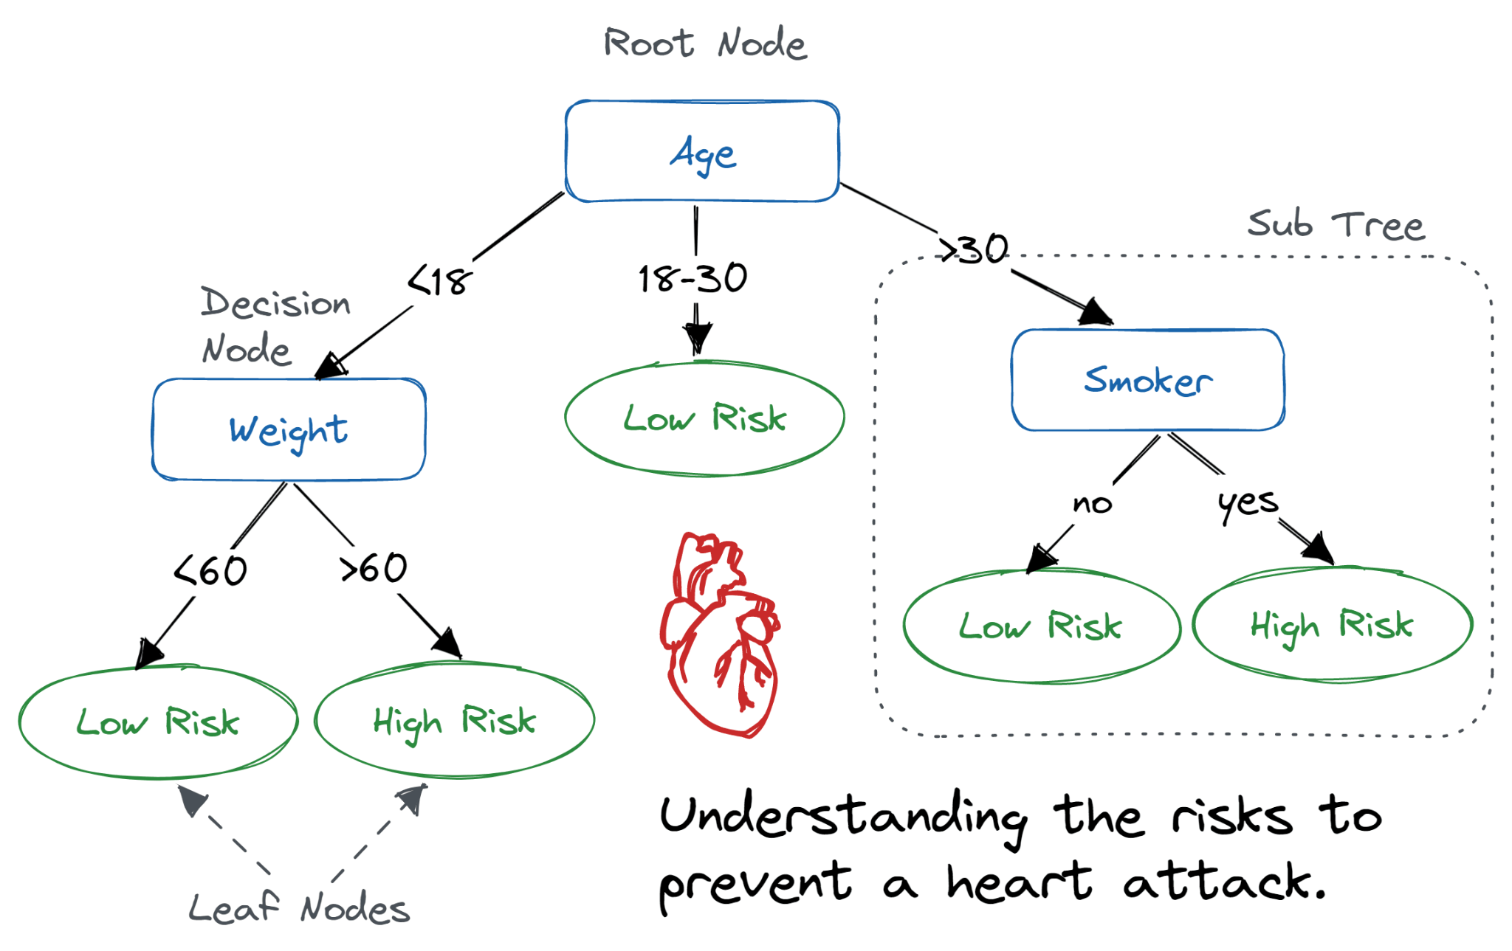
Decision Trees
tree can be “learned” by splitting the source set into subsets based on Attribute Selection Measures, which is a criterion used to evaluate the usefulness of different attributes for splitting a dataset
less requirement of data cleaning compared to other algorithms
useful for solving decision-related problems
Notes:
The decision tree contains lots of layers, which makes it complex.
It may have an overfitting issue, which can be resolved using the Random Forest algorithm.
For more class labels, the computational complexity of the decision tree may increase
Greedy algorithm*
Determining credit worthiness depending on credit history

Slide 27
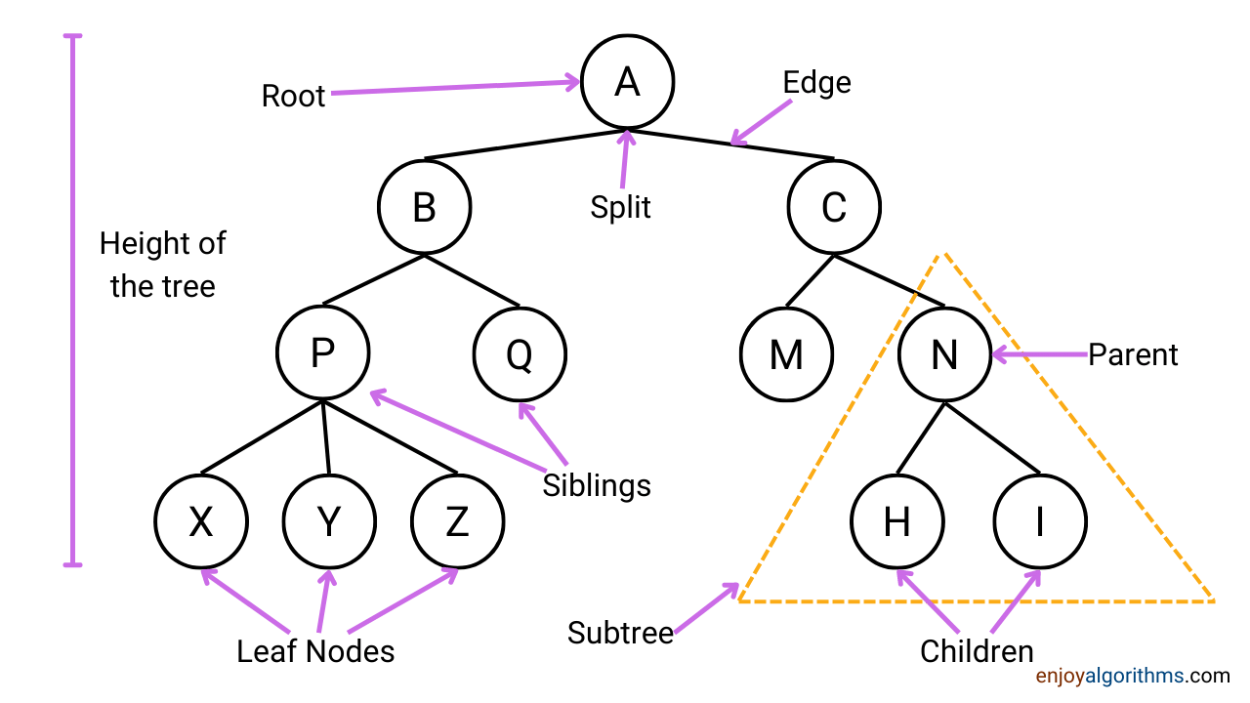
Decision Trees

Slide 28
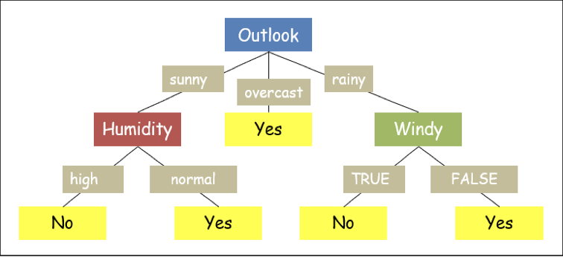
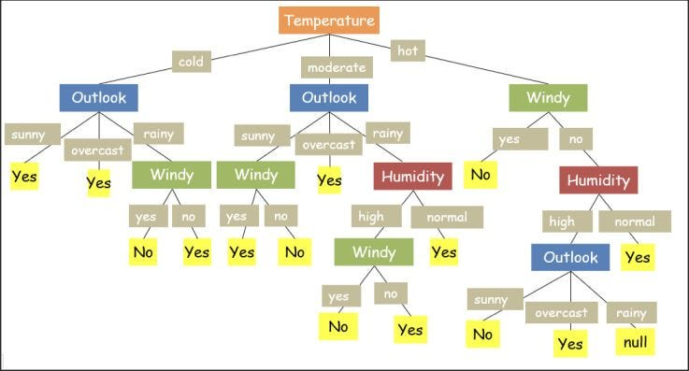
Notes:
Example of the dataset: why i love decision trees is that it allows you to extract multiple predictions from the same data, depending on how you establish your sequence of features

